Slide 1
‘Make-II’ Procedure and details of Projects

Slide 2
SCOPE OF PRESENTATION
‘Make’ Scheme
Make –II Procedure
Make II Projects which have been accorded ‘Approval –in-Principle’

Slide 3
MAKE SCHEME

Slide 4
“MAKE” – DPP 2016
“Make” categorisation of defence procurement aims at
Developing long-term indigenous defence capabilities
Act as vital pillar for realising vision behind “Make in India” initiative
Acquisition's under “Make” includes
Equipment/System/Assembly/Sub-assembly
Major Components and System Upgrades

Slide 5
“MAKE” – DPP 2016
‘Make’ Categories
Make –I (Govt Funded)
90% Govt. Funding
Released in Phased Manner
Make – II (Industry Funded)
Impetus for MSME/Start-ups
Wider Participation of Indian industry
Involves Prototype Development
- Focus on Import Substitution

Slide 6
‘Make II’ Procedure Chapter III A of DPP 2016
Reference : ‘www.makeinindiadefence.gov.in’

Slide 7
“MAKE-II” – PROCESS FLOW
Advance Planning & Consultation
Approval-in-Principle (AIP)
Feasibility Study
Prelim. Staff Qualitative Requirements (PSQRs)
Preparation of SoC & Formation of PFT
Accord of ‘Acceptance of Necessity’ (AON)
Issue of Expression of Interest (EoI)
EoI Response submission

Slide 8
“MAKE-II” – PROCESS FLOW
EoI Response Evaluation
Award of Project Sanction Order
Design & Development of Prototype
Conversion of PSQRs to SQRs
Solicitation of Commercial Offer
User Trials (Both Vendor & User involved)
Staff Evaluation
Commercial Negotiations
Award of Contract (Buy-Indian: IDDM)

Slide 9
ADVANCE PLANNING & CONSULTATIONS
Advance Plg. & Consultations : Tasks
Identify Potential Projects
Discussions with DRDO, HQIDS,DDP
AIP : Accorded by Secy (DP)
Project Brief, Questionnaire Uploaded
“www.makeinindiadefence.gov.in”
Notes:
- On the basis of LTIPP or otherwise, identify potential projects
- Initiate collegiate discussions with various stakeholders such as DRDO, DDP, Industries in early stages after approval of LTIPP
- Potential R&D Institution or DAs would put in requisite efforts.
- Based on discussions, SHQs will forward an indicative list of potential ‘Make’ projects alogwith PSQRs to HQ IDS for inclusion in relevant medium and short term plan.
Make I Sub Categorization:
- Design related Major platform upgrade
- Usually Make I projects would involve developmental period of not less than three years
- Estimated cost of prototype dev phase not exceeding Rs 10 Cr will be earmarked for MSMEs
- In case at least two MSMEs do not express interest for Make I program of less than 10 Cr, the same shall be opened up for all
Make II Sub Categorization:
- Design related Minor platform
- Import substitution will be key focus of the projects
- Estimated cost of prototype dev phase not exceeding Rs 10 Cr will be earmarked for MSMEs
- In case no MSMEs do not express interest for Make I program of less than 10 Cr, the same shall be opened up for all
AAP on same line as ch I of DDP wil be prepared

Slide 10
FEASIBILITY STUDY
Stakeholders : IHQ, DRDO, HQ IDS, DDP, MoD(Fin), Industries
Deliverables:
Assessment of Industry Capability
Duration for Development
Cost
- Prototype Development
- Subsequent Procurement
Notes:
- On the basis of LTIPP or otherwise, identify potential projects
- Initiate collegiate discussions with various stakeholders such as DRDO, DDP, Industries in early stages after approval of LTIPP
- Potential R&D Institution or DAs would put in requisite efforts.
- Based on discussions, SHQs will forward an indicative list of potential ‘Make’ projects alogwith PSQRs to HQ IDS for inclusion in relevant medium and short term plan.
Make I Sub Categorization:
- Design related Major platform upgrade
- Usually Make I projects would involve developmental period of not less than three years
- Estimated cost of prototype dev phase not exceeding Rs 10 Cr will be earmarked for MSMEs
- In case at least two MSMEs do not express interest for Make I program of less than 10 Cr, the same shall be opened up for all
Make II Sub Categorization:
- Design related Minor platform
- Import substitution will be key focus of the projects
- Estimated cost of prototype dev phase not exceeding Rs 10 Cr will be earmarked for MSMEs
- In case no MSMEs do not express interest for Make I program of less than 10 Cr, the same shall be opened up for all

Slide 11
CONSTITUTION OF PFT
Chairman
DGQA
Member Secretary
Prof Dte &DOI
MoD/
DDP
MoD/ Fin

Slide 12
PROJECT FACILITATION TEAM (PFT)
Responsibilities of PFT
Prepare & Issue EoI (RFP for Tech. Proposal)
Evaluation of EoI Response
Prepare Project Sanction Order (with ‘Nil’ Fin. Implication)
Interface between IN & Industry during Project Execution
Notes:
- On the basis of LTIPP or otherwise, identify potential projects
- Initiate collegiate discussions with various stakeholders such as DRDO, DDP, Industries in early stages after approval of LTIPP
- Potential R&D Institution or DAs would put in requisite efforts.
- Based on discussions, SHQs will forward an indicative list of potential ‘Make’ projects alogwith PSQRs to HQ IDS for inclusion in relevant medium and short term plan.
Make I Sub Categorization:
- Design related Major platform upgrade
- Usually Make I projects would involve developmental period of not less than three years
- Estimated cost of prototype dev phase not exceeding Rs 10 Cr will be earmarked for MSMEs
- In case at least two MSMEs do not express interest for Make I program of less than 10 Cr, the same shall be opened up for all
Make II Sub Categorization:
- Design related Minor platform
- Import substitution will be key focus of the projects
- Estimated cost of prototype dev phase not exceeding Rs 10 Cr will be earmarked for MSMEs
- In case no MSMEs do not express interest for Make I program of less than 10 Cr, the same shall be opened up for all

Slide 13
EXPRESSION OF INTERST
AON by Competent Authority
EoI : Uploaded in DDP Website
EoI
- Scope of Project , Nos. of Prototype
- Timeframes & Critical Activities
- List of Trials/ Facilities /Items (By IN)& No. of Trials
- Qty for Subsequent Procurement Under ‘Buy (Indian - IDDM)’
- Acceptability of Multiple Technology Solution
- Evaluation Criteria: Technical, Commercial & Financial

Slide 14
EVALUATION OF ‘EOI’ RESPONSE
Evaluation of EOI Response against
Technical
Commercial &
Financial Criteria
Shortlisted Firms – Development Agencies
Sanction for Prototype Development
(with Nil Financial Implications)
Notes:
- On the basis of LTIPP or otherwise, identify potential projects
- Initiate collegiate discussions with various stakeholders such as DRDO, DDP, Industries in early stages after approval of LTIPP
- Potential R&D Institution or DAs would put in requisite efforts.
- Based on discussions, SHQs will forward an indicative list of potential ‘Make’ projects alogwith PSQRs to HQ IDS for inclusion in relevant medium and short term plan.
Make I Sub Categorization:
- Design related Major platform upgrade
- Usually Make I projects would involve developmental period of not less than three years
- Estimated cost of prototype dev phase not exceeding Rs 10 Cr will be earmarked for MSMEs
- In case at least two MSMEs do not express interest for Make I program of less than 10 Cr, the same shall be opened up for all
Make II Sub Categorization:
- Design related Minor platform
- Import substitution will be key focus of the projects
- Estimated cost of prototype dev phase not exceeding Rs 10 Cr will be earmarked for MSMEs
- In case no MSMEs do not express interest for Make I program of less than 10 Cr, the same shall be opened up for all

Slide 15
DESIGN & DEVELOPMENT
Role of PFT
Interface with Industry
Provide Professional Inputs to Dev. Agency
Conversion of PSQR to SQR
Issue of RFP for Commercial Offer
Review ‘User Trial’ Readiness
Notes:
- On the basis of LTIPP or otherwise, identify potential projects
- Initiate collegiate discussions with various stakeholders such as DRDO, DDP, Industries in early stages after approval of LTIPP
- Potential R&D Institution or DAs would put in requisite efforts.
- Based on discussions, SHQs will forward an indicative list of potential ‘Make’ projects alogwith PSQRs to HQ IDS for inclusion in relevant medium and short term plan.
Make I Sub Categorization:
- Design related Major platform upgrade
- Usually Make I projects would involve developmental period of not less than three years
- Estimated cost of prototype dev phase not exceeding Rs 10 Cr will be earmarked for MSMEs
- In case at least two MSMEs do not express interest for Make I program of less than 10 Cr, the same shall be opened up for all
Make II Sub Categorization:
- Design related Minor platform
- Import substitution will be key focus of the projects
- Estimated cost of prototype dev phase not exceeding Rs 10 Cr will be earmarked for MSMEs
- In case no MSMEs do not express interest for Make I program of less than 10 Cr, the same shall be opened up for all
AAP on same line as ch I of DDP wil be prepared

Slide 16
SOLICITATION OF COMMERCIAL OFFER
RFP for ‘Buy (Indian - IDDM) will be issued to all DA(s)
Eqpt. Qty : Specified & Fixed in EoI
Submission of Commercial Offer
- Prior User Trials
Notes:
- On the basis of LTIPP or otherwise, identify potential projects
- Initiate collegiate discussions with various stakeholders such as DRDO, DDP, Industries in early stages after approval of LTIPP
- Potential R&D Institution or DAs would put in requisite efforts.
- Based on discussions, SHQs will forward an indicative list of potential ‘Make’ projects alogwith PSQRs to HQ IDS for inclusion in relevant medium and short term plan.
Make I Sub Categorization:
- Design related Major platform upgrade
- Usually Make I projects would involve developmental period of not less than three years
- Estimated cost of prototype dev phase not exceeding Rs 10 Cr will be earmarked for MSMEs
- In case at least two MSMEs do not express interest for Make I program of less than 10 Cr, the same shall be opened up for all
Make II Sub Categorization:
- Design related Minor platform
- Import substitution will be key focus of the projects
- Estimated cost of prototype dev phase not exceeding Rs 10 Cr will be earmarked for MSMEs
- In case no MSMEs do not express interest for Make I program of less than 10 Cr, the same shall be opened up for all
AAP on same line as ch I of DDP wil be prepared

Slide 17
USER TRIALS
PFT will Formulate Trial Directives & Trial Team
User Trials : Essential Parameters will be Tested
User may Recommend Modifications
(for Ease of Handling but no Design Modification Allowed at this Stage)
Notes:
- On the basis of LTIPP or otherwise, identify potential projects
- Initiate collegiate discussions with various stakeholders such as DRDO, DDP, Industries in early stages after approval of LTIPP
- Potential R&D Institution or DAs would put in requisite efforts.
- Based on discussions, SHQs will forward an indicative list of potential ‘Make’ projects alogwith PSQRs to HQ IDS for inclusion in relevant medium and short term plan.
Make I Sub Categorization:
- Design related Major platform upgrade
- Usually Make I projects would involve developmental period of not less than three years
- Estimated cost of prototype dev phase not exceeding Rs 10 Cr will be earmarked for MSMEs
- In case at least two MSMEs do not express interest for Make I program of less than 10 Cr, the same shall be opened up for all
Make II Sub Categorization:
- Design related Minor platform
- Import substitution will be key focus of the projects
- Estimated cost of prototype dev phase not exceeding Rs 10 Cr will be earmarked for MSMEs
- In case no MSMEs do not express interest for Make I program of less than 10 Cr, the same shall be opened up for all
AAP on same line as ch I of DDP wil be prepared

Slide 18
POST USER TRIALS
Staff Evaluation
Commercial Bids of Successful DAs Opened
Commercial Negotiation by CNC
Post CNC, Procurement will be Progressed as - Buy (Indian- IDDM)
Multiple Technological Solution
Option for Procurement from L2 vendor in 70:30 Ratio, provided 2nd DA Accepts Terms & Conditions and Price of L1
All other successful DAs will be given Certificate
Notes:
- On the basis of LTIPP or otherwise, identify potential projects
- Initiate collegiate discussions with various stakeholders such as DRDO, DDP, Industries in early stages after approval of LTIPP
- Potential R&D Institution or DAs would put in requisite efforts.
- Based on discussions, SHQs will forward an indicative list of potential ‘Make’ projects alogwith PSQRs to HQ IDS for inclusion in relevant medium and short term plan.
Make I Sub Categorization:
- Design related Major platform upgrade
- Usually Make I projects would involve developmental period of not less than three years
- Estimated cost of prototype dev phase not exceeding Rs 10 Cr will be earmarked for MSMEs
- In case at least two MSMEs do not express interest for Make I program of less than 10 Cr, the same shall be opened up for all
Make II Sub Categorization:
- Design related Minor platform
- Import substitution will be key focus of the projects
- Estimated cost of prototype dev phase not exceeding Rs 10 Cr will be earmarked for MSMEs
- In case no MSMEs do not express interest for Make I program of less than 10 Cr, the same shall be opened up for all
AAP on same line as ch I of DDP wil be prepared

Slide 19
Navy Projects – 11 Nos.

Slide 20
MAKE II PROJECTS - AIP ACCORDED
 | Name of Project
1 | Deep Sea Side Scan Sonar Towing Winch (DS4TW)
2 | Upper Air Sounding System (UASS)
3 | Expendable Underwater Target
4 | Water Electrolysis Bi-Polar Hydrogen Generator
5 | Digital Beamforming Based Satellite TV (DB2 ST)
6 | Universal Proximity, Direct Action And Graze Fuses For Gun Ammunition Of 76 - 127mm

Slide 21
‘MAKE II’ PROJECTS - AIP ACCORDED
 | Project
7 | NVG Adaptation Filters & Image Intensifiers
8 | Three Phase inverters
9 | Detonator N5 MK2 for CDSC 0.5 Kg with VH2 Based Composition
10 | Electronic Fuze for Anti-Submarine Rocket RGB-60
11 | Detonator 7 Sec Delay for Hand Grenade 36

Slide 22
DEEP SEA SIDE SCAN SONAR TOWING WINCH
The Deep Sea Side Scan Sonar towing winch (DS4TW) in hydrographic surveying,
Towing of deep sea side scan sonar for deep sea bottom scanning
Delineation of underwater wreck
Self-contained, electro-hydraulic winch made of stainless steel connected with 1500 mtrs of double armoured coaxial tow cable of dia 10-12 mm in sea state 3-4 at ship speed upto 10 knots
System must meet IMO and IEC standards for deck equipment (marine standard) or equivalent Indian standard
Cost – 5.54 Cr (Qty-06 Nos)
PFT - Capt Gurumani (26181834)
Cdr AG Merwade

Slide 23
UPPER AIR SOUNDING SYSTEM (UASS)
UASS is an equipment for obtaining vertical profile of meteorological parameters
The equipment consists of two parts:-
Ground Receiving Station , antennas and accessories
Consumable unit consisting:-
Met sensors & transmitter (Radiosonde)
Met balloons & Hydrogen
The sensors with the attached transmitter are released into the atmosphere with the help Hydrogen filled meteorological balloons and the data received is processed by the ground station
Cost – 40 Cr (60 systems and 12000 Radiosondes)
PFT – Cmde Manoj Kumar Singh (23093274)
Cdr A Vidyasagar (23010139)

Slide 24
EXPENDABLE UNDERWATER TARGET (EUT)
EUT is required to emulate the presence of a Submarine for Sonar operators to detect and track
Salient Features:-
Operate independently Underwater and Manoeuvre along a pre-determined path
Imitate Acoustic Signature of Manoeuvring Submarine
Capable of being launched from Ships or Helicopters
Active Sonar repeater 3 – 35 Khz
Broadband Noise 100 – 2000 Hz
Operating at depth of 150 m
Lightweight < 50 Kg
Capable of 8 knots speed
Min endurance of 4 hrs
PFT – Capt Ritchie Ranjan (23011680)
Cdr V Moorjani (23010948)

Slide 25
WATER ELECTROLYSIS BI-POLAR HYDROGEN GENERATOR
Generate Hydrogen only from raw feed of water (no chemicals to be used and no chemical wastage to be generated)
Safety features during generation of Hydrogen, stowage in cylinders and while transferring of gas from cylinders to the balloon filling unit
Small size equipment (to fit in a room/ ship’s compartment of minimum size 12 ft x 12 ft)
Environmental friendly and MARPOL compliant
Limited and low cost maintenance
Continuous availability of Hydrogen gas leading to optimal utilisation of UASS for building of reliable atmospheric database
Cost – One Cr/ System (Qty-10 Systems)
PFT – Cmde Manoj Kumar Singh (23093274)
Cdr A Vidyasagar (23010139)

Slide 26
Digital Beamforming Based Satellite TV DB2 ST
Digital Beamforming Based Satellite TV System is used for uninterrupted reception in rough seas
Salient Features:-
Small Form Factor – No Mechanical Part
Uninterrupted Worldwide Reception
Cost – 1.4 Cr/ Set, to be ascertained during Industry Interaction/ Feasibility Studies (Qty-100 Nos.)
PFT – Capt Vivek Sharma (23011668)
Cdr Akshay R Prabhu(23011101)

Slide 27
NVG ADAPTATION FILTERS AND IMAGE INTENSIFIERS
Indigenous development and supply of image intensifier tubes for night vision goggles
Development of Gen 3 Night Vision Imaging System (NVIS) adapted for usage on board Multirole and Utility Helicopters
Salient Features:-
Self-contained power source for primary and back up power for extended missions in harsh environmental and operating conditions
Capability of sustained usage in vibration environment
Long total service life in years (10 years / 10,000 operating hours at less than 10% SNR degradation)
Good performance in entire range of full moonlight to starlight conditions
Qty – 504 nos.
PFT – Capt Brijesh Singhania (23010332)
Cdr Rishab Batra (23011247)

Slide 28
THREE PHASE INVERTERS
Salient Features:-
End User – Dornier
Main System – ELTA Maritime Patrol Radar E/L/M 2022A V(3)
Sub System – Static Inverter
Input – 28 V DC
Output:-
270 V DC for Tx Assembly
115 V AC 3 phase, 400 Hz for RPA
Power Output – 6 KVA approx.
Cost – 30 Lakh/ Set (Qty – 25 nos.)
PFT – Capt Brijesh Singhania (23010332)
Cdr Rishab Batra (23011247)

Slide 29
DETONATOR N5 MK2 FOR CDSC 0.5 KG WITH VH2 BASED COMPOSITION
Salient Features:-
The detonator, when initiated by the 0.22 RF cap(with VH-2 composition), should ensure explosion of CDSC 0.5kg
The detonator should ensure a specified delay life > 10 years
Cost – 8.1 Cr (Qty – 180000 nos.)
PFT – Capt GR Wani (26194691)
Cdr S Dutt Roy (26194649)

Slide 30
ELECTRONIC FUZE FOR ANTI-SUBMARINE ROCKET RGB 60
To be designed to explode the anti-submarine rocket RGB -60 at a preset depth or upon hitting the underwater target
It should operate within the designated depth envelope:-
Length - 361mm
Dia. - 135mm
Weight - 6.5kg
Life > 10 years
Cost – 1.3 Cr (Qty – 500/ Yr)
PFT – Capt GR Wani (26194691)
Cdr S Dutt Roy (26194649)

Slide 31
PROXIMITY, DA AND GRAZE FUZE FOR 76/62 SRGM WITH UNIVERSAL CAPABILITY FOR 76-127MM AMMUNITION
It is proposed that the fuze for 76/62 SRGM be developed as an universal fuze with electronics that can be adapted for higher calibers
IN uses guns of calibers in the range of 76mm to 100mm, and envisaged to use guns of higher caliber up to 127mm
Salient features:-
Universal fuze should be adaptable to functioning in proximity(default) or DA mode
Graze action backup
Proximity mode should have Self Destruct option after a specified flight time as backup
Cost – 6000 per unit (Qty- 5000 fuzes @ 500/ Yr)
PFT – Capt GR Wani (26194691)
Cdr S Dutt Roy (26194649)

Slide 32
DETONATOR 7 SEC DELAY FOR HAND GRENADE 36M
The detonator, when initiated by the 0.22 RF cap(with VH-2 composition), should ensure explosion of CDSC 0.5kg
The detonator should ensure a specified delay life > 10 years
Cost – 800 per detonator (Qty- 5000)
PFT – Capt GR Wani (26194691)
Cdr S Dutt Roy (26194649)

Slide 33
Army Projects

Slide 34
MAKE II PROJECTS - AIP ACCORDED
 | Project
1 | Upgraded Assault Trackway
2 | MEAT (MANEOVERABLE EXPANDABLE AERIAL TARGET)
3 | 125 mm APFSDS for T-72 & T-90 Tanks
4 | Light Weight Body Armour
5 | Individual Protection System with inbuilt Sensors
6 | Pre fragmented Programmable Proximity Fuse Ammunition

Slide 35
UPGRADED ASSAULT TRACK WAY
Sponsor Dte | Qty | Cost | AoN | Stg | Vendor Base /DAs
DG CE | 100 | 100 Cr | 2017 | IPMT
Brief of Case
The equipment is held with Engineers for construction of operational tracks in under developed/desert terrain. The present ATW Class 12 has its limitations and a new track way is envisaged to support move of vehicles of weight upto 25,000kgs and will be lighter in weight with a reduced volume for faster employment This eqpt will replace the inservice ATW Cl-12
Milestones
AoN accorded on 28 Jun 17 EoI hosted on MoD website on 19 Mar 18
Proj Offr: Col Vikram Gulati Dir CE -5(B), DG CE ,Kashmir House, Rajaji Marg , New Delhi - 110011 Tele : 23019604 ,Fax : 23019675 , E-mail : ce5-einc-army@nic.in

Slide 36
MEAT (MANEOVERABLE EXPANDABLE AERIAL TARGET)
Sponsor Dte | Qty | Cost | AoN | Stg | Vendor Base/ DAs
DG AAD | 50/Yr | 79 Cr | - | AoN
Brief of Case
MEAT is required to provide realistic live firing practice to crews of Air Defence weapons of Army, particularly the crews of long range missiles. The MEAT should be capable of a maximum speed of 400 Kmph or more and an altitude range of 20 m to 5000 m. It would be ground launched The case is at an advanced stage of accord of approval
Milestones
EoI uploaded on 13 Apr 18

Slide 37
125MM APFSDS AMMUNITION FOR T-72/T- 90
Sponsor Dte | Qty | Cost | AoN | Stg | Vendor Base/ DAs
DG CE | 1000 | 2500 Cr | - | AoN
Brief of Case
125mm APFSDS ammunition is primary tank ammunition utilised for destroying enemy tanks. There is a requirements to develop an indigenous APFSDS ammunition for T-72/T-90 tanks with a capability of achieving Depth of Penetration (DoP) of more than 600mm to enhance lethality within the existing safety and consistency parameters The case is at an advanced stage of accord of approval
Milestones
PSQR approved in GSEPC on 18 Jul 17 Case to be fd in SCAP cycle in May 18
Proj Offr : Col Vishal Singh Dir ISE (AC), DG MF , A Wing Sena Bhawan, Tele No 23335093

Slide 38
LIGHT WEIGHT BODY ARMOUR
Sponsor Dte | Qty | Cost | AoN | Stg | Vendor Base/ DAs
DG Inf | 1800000 | 930 | - | Feasibility Study
Brief of Case
The Bullet Proof Jackets presently do not provide adequate protection to all the vital organs of a solider The weight is the biggest challenge in order to enable the soldier to operate in field with maximum efficiency The threat to the soldier is increased day by day from low to medium and to high velocity projectiles Therefore, there is a need to equip the soldier with light weight Body Armour, so as to have adequate protection against the varied threat levels
Milestones
Inadequate vendor response at Feasibility Study stg. Time extn for Feasibility Study reqd
Proj Offr : Col H Kataria, SM Dir Inf - 3, Room No 415,D Wing Sena Bhawan Tele No- 011-23333819

Slide 39
INDL PROTECTION SYS WITH INBUILT SENSORS
Sponsor Dte | Qty | Cost | AoN | Stg | Vendor Base/ DAs
DG RR | 59825 | - | - | Feasibility Study
Brief of Case
For CI/CT Ops A vital part of this adoption will constitute individual protection gear of the soldiers. In addition to monitor pers medical parameters to incl BP, Pulse and other vitals for speedy and realistic cas evac during ops.
Milestones
At Feasibility Study stg
Proj Offr : Col Aditya Mishra Dir RR-2, DG RR Delhi Cantt Tele No 011-25692895

Slide 40
PRE FRAGMENTED PROGRAMMABLE PROXIMITY FUZED AMMUNITION
Sponsor Dte | Qty | Cost | AoN | Stg | Vendor Base/ DAs
DG AAD | 9 Lac | - | - | Feasibility Study
Brief of Case
With the increase in air threat envelope and multiplicity of air threat platforms, there is a requirement to enhance the lethality and accuracy of the present air defence ammunition of L70 gun system. The ammunition should have multi target handling capability along with capabilities of air burst, proximity, point detonation and variable and programmable provisions.
Milestones
At Feasibility Study stg
Proj Offr: Col Rajesh Tanwar Dir (Planning), Army Air Def Directorate, Room No – 606 D-1 Wing Tele/ Fax :23339001/23333632

Slide 41
Air Force Projects

Slide 42
MAKE II PROJECTS - AIP ACCORDED
 | Project
1 | Chaffs & Flares
2 | Long Range Dual Band Infrared Search and Track system (IRST)
3 | Advanced Self Protection Jammer (ASPJ) Pods and Radar Warning Receiver
4 | Aerial Fuses for Bomb
5 | 125 kg bomb (akin to MK-81 bomb)
6 | Air to Ground Rockets
7 | Foldable Fiberglass Mat (FFM) for Rapid Runway Repair
8 | 7.62mm Ammunition for Galil sniper rifle (NATO), 5.56mm Ammunition for Negev LMG (NATO belted) 5.56mm Ammunition for TAVOR Assault Rifle (NATO)

Slide 43
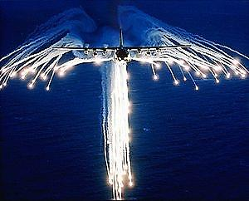
CHAFFS AND FLARES

Slide 44
CHAFFS AND FLARES
Brief :
Chaffs and Flares are countermeasure devices used by aircraft against enemy radar, radar guided missiles and heat seeking missiles
These are fired in order to mislead the IR seekers and sensors
Requirement is large and recurring
Quantity: Chaffs-10 lakh (for five years)
Flares-1.5 lakh (for five years)
Approx. Cost: Rs 142.62 Crore

Slide 45
LONG RANGE DUAL BAND INFRARED IMAGING SEARCH AND TRACK SYSTEM (IRST)

Slide 46
LONG RANGE DUAL BAND INFRARED IMAGING SEARCH AND TRACK SYSTEM (IRST)
Brief
System should be form fit compatible with existing system on fighter aircraft
Mechanical & electrical requirements of the system should be same as that of the existing system on aircraft (OLS)
New system should interface with the aircraft mission computer and exchange necessary target information
Quantity: 100
Approx. Cost : 2000 Cr

Slide 47
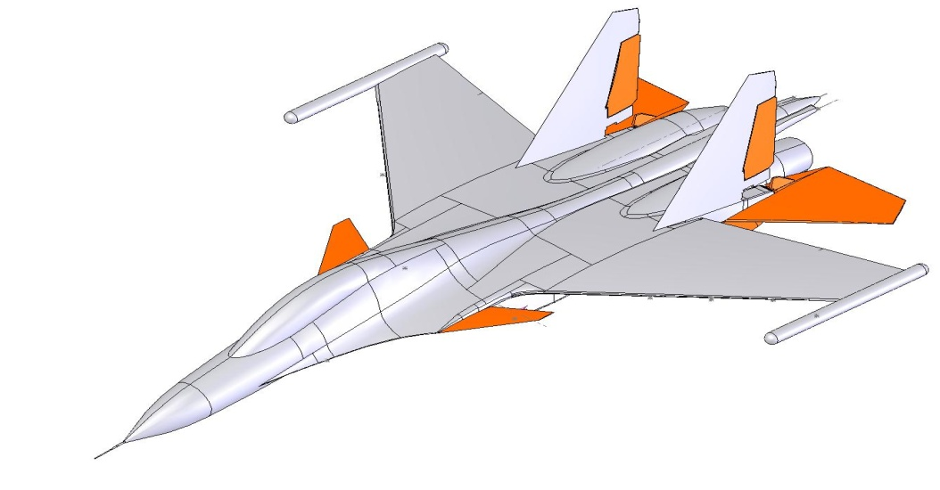
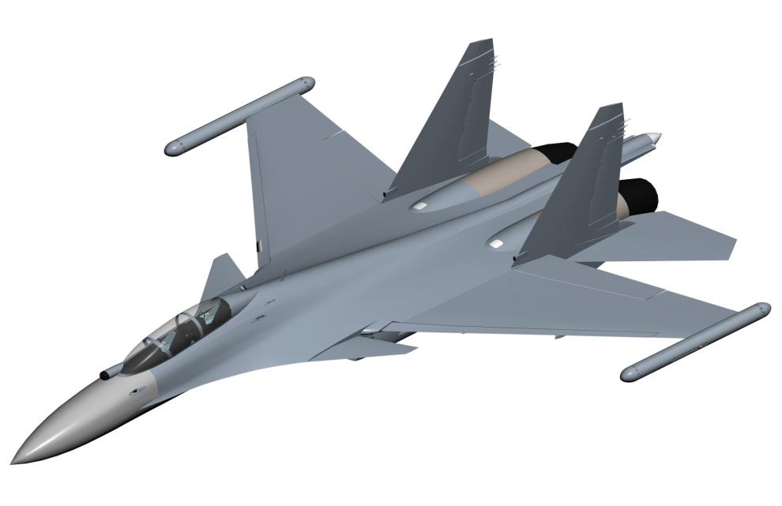
ADVANCED SELF PROTECTION JAMMING(ASPJ) AND RADAR WARNING RECEIVER
Receiving pod
EW Pod
Transmitting pod

Slide 48
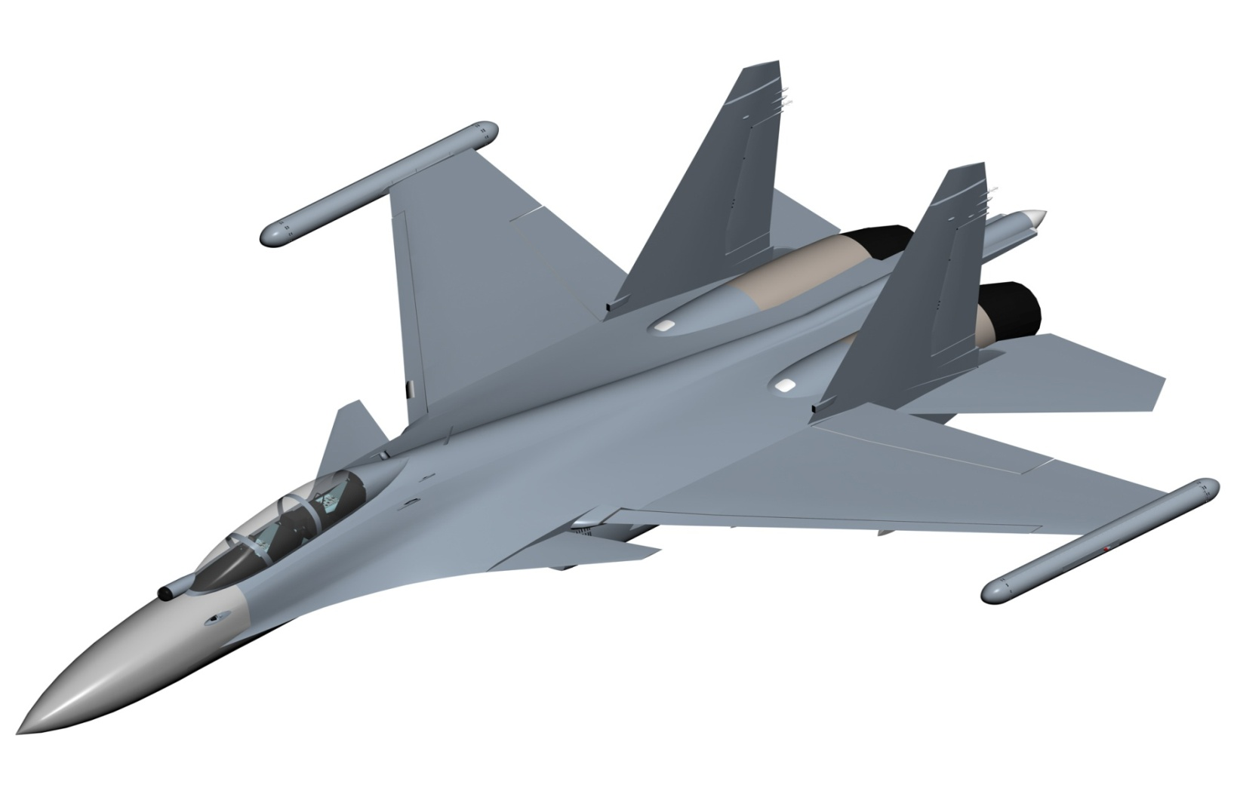
ADVANCED SELF PROTECTION JAMMING(ASPJ) PODS
Receiving pod
Transmitting pod

Slide 49
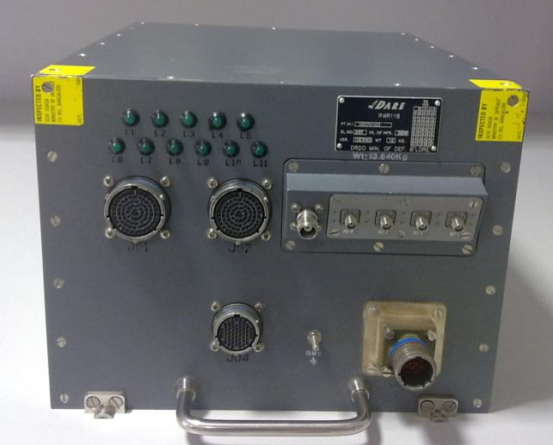
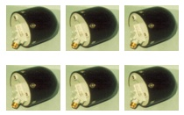
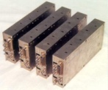
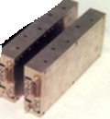
RADAR WARNING RECEIVER
Processing Unit
1-18 GHz Spiral Antennas
RF Units (RFU)
EW Pod
RWR Ant

Slide 50
RWR AND ASPJ PODS
ASPJ
Fully automatic, capable of intercepting, analyzing, categorizing, prioritizing and initiating optimum counter offensive using active jamming techniques against multiple threats in a dense EW environment
RWR
Radar Warning Receiver detects and identifies various radar emitters (ground based & airborne), provides direction and approximate range of emitter
System is used to improve situational awareness
System is used for queuing the CMDS for self protection
Quantity: 100

Slide 51
AERIAL FUSE FOR BOMB
Aerial fuse for Bomb
Should be capable to withstand high speed and ‘g’ forces during carriage and should be activated only when desired ‘g’ forces are attained.
Quantity: 3000 (per year)

Slide 52
125 KG BOMB
Brief :
Design & development of 125 Kg Bomb (akin to MK-81 Bomb)
The bomb should have facility for nose fusing as well as tail fusing of the store with fuse AVU-ETM/ETMA and any futuristic fuse
Quantity: 500

Slide 53
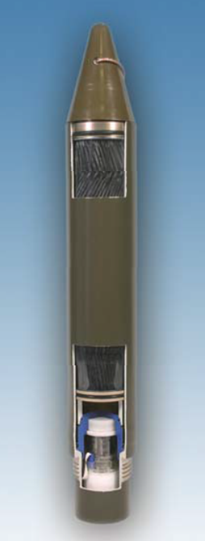
70 mm AIR TO GROUND ROCKETS

Slide 54
70 mm AIR TO GROUND ROCKETS
Brief :
Development of 70 mm air to ground rockets for various platforms of IAF
Requirement large and recurring
Quantity: 80,000 (total) (over 3-5 years).
Approx. Cost : Feasibility study in progress

Slide 55
FOLDABLE FIBREGLASS MAT (FFM)
Brief
Rigid, light weight composite material reinforced with specially developed fibre glass polyster resin weaved and cut to shape to provide the mat. New technique to repair large size crater.
Qty to be procured – Approx. 122 sets per year
Cost - Rs 192 crores approx ( to be ascertained during industry interaction/feasibility study)
Timeline – 2 yrs

Slide 56
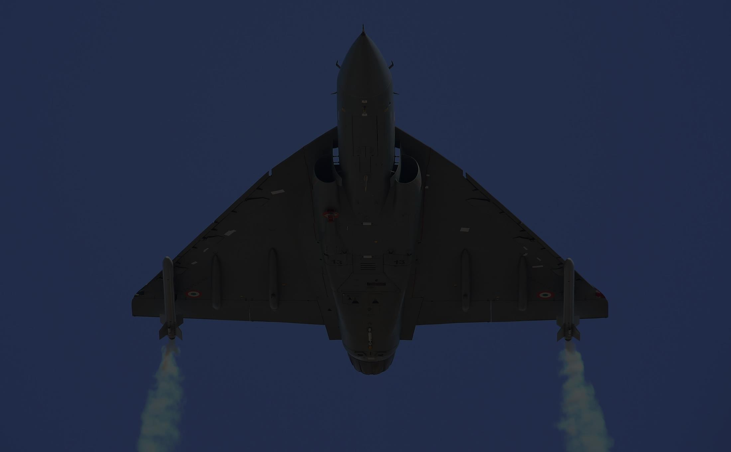
GARUD AMMUNITION
Brief :
Development of 7.62 mm ammunition for GALIL sniper rifle
Quantity: 1,13,000 rounds (per year) (AF)
Development of 5.56 mm ammunition for NEGEV LMG
Quantity: 15,00,000 (per year) (AF) + 3,00,000 (IN)
Development of 5.56 mm ammunition for TAVOR assault rifle
Quantity: 18,50,000 rounds (per year) (AF)

Slide 57
Thank you

Slide 58
Deep Sea Side Scan Sonar Towing Winch (DS4TW) DOH
Scheme (Qty/ Cost/ Cat/ DAs) | Remarks
Qty : 06 Cost : 5.54 Cr (AoN) Cat : Make II | Purpose. The Deep Sea Side Scan Sonar towing winch (DS4TW), in hydrographic surveying, is used for towing of Deep sea side scan sonar for deep sea bottom scanning and delineation of underwater wreck Regulations/Standards. The system must meet IMO and IEC standards for Deck Equipment (marine standard) or equivalent Indian standard Functionality. A self-contained, electro-hydraulic winch made of stainless steel capable of towing deep sea side scan sonar connected with 1500 meters of double armoured coaxial tow cable of dia 10-12 mm cable in sea state 3-4 at ship speed upto 10 knots
58

Slide 59
UPPER AIR SOUNDING SYSTEM (UASS)
Upper Air Sounding System (UASS) is an equipment for obtaining vertical profile of meteorological parameters.
The equipment consists of two parts:-
(a) Ground Receiving Station , antennas and accessories
(b) Consumable unit consisting of:-
(i) Met sensors & transmitter (Radiosonde)
(ii) Met balloons & Hydrogen

Slide 60
UPPER AIR SOUNDING SYSTEM (UASS)
For Vertical profiling, the sensors with the attached transmitter are released into the atmosphere with the help Hydrogen filled meteorological balloons. The transmitted data is received & processed by the ground station.
The meteorological parameters recorded : Temperature , Humidity, Atmospheric Pressure ,Wind speed & direction , Refractive index profile (a derived product)
The data obtained is used : Weather forecasting,Planning of air operations, Missile firing, Assessment of atmospheric ducts

Slide 61
Electrolysis Based Hydrogen Generator DNOM
Scheme (Qty/ Cost/ Cat/ DAs) | Remarks
Cat : Make II Cost : 1 Cr/ System Qty : 10 Systems | Small size equipment (to fit in a room/ ship’s compartment of minimum size 12 ft x 12 ft) Enough inbuilt safety features during generation of Hydrogen, stowage in cylinders and while transferring of gas from cylinders to the balloon filling unit Should generate Hydrogen only from raw feed of water and ship/ Unit electric supply (no chemicals to be used and no chemical wastage to be generated) Environmental friendly and MARPOL compliant Limited and Low cost maintenance to be catered through CAMC Continuous availability of Hydrogen gas leading to optimal utilisation of UASS for building of reliable atmospheric database

Slide 62
Digital Beamforming Based Satellite TV DB2 ST DEE
Scheme (Qty/ Cost/Cat/ DAs) | Remarks
Cat : Make II Cost : Rs 1.4 Cr/ Set (to be ascertained during Industry Interaction/ Feasibility Studies) Qty : 100 | Digital Beamforming Based Satellite TV System Uninterrupted Reception in Rough Seas Small Form Factor – No Mechanical Parts Uninterrupted Worldwide Reception
62

Slide 63
NVG Adaptation Filters and Image Intensifiers
Brief Specifications : Development of Gen 3 Night Vision Imaging System (NVIS) adapted for usage on board Multirole and Utility Helicopters in the Indian Navy. The system must contain self-contained power source for primary and back up power for extended missions in harsh environmental and operating conditions. It must meet following broad capabilities and specifications:-
Capability of sustained usage in vibration environment
Long total service life in years (10 years / 10,000 operating hours at less than 10% SNR degradation)
Good performance in entire range of full moonlight to starlight conditions.
Quantity : 504 (At least)

Slide 64
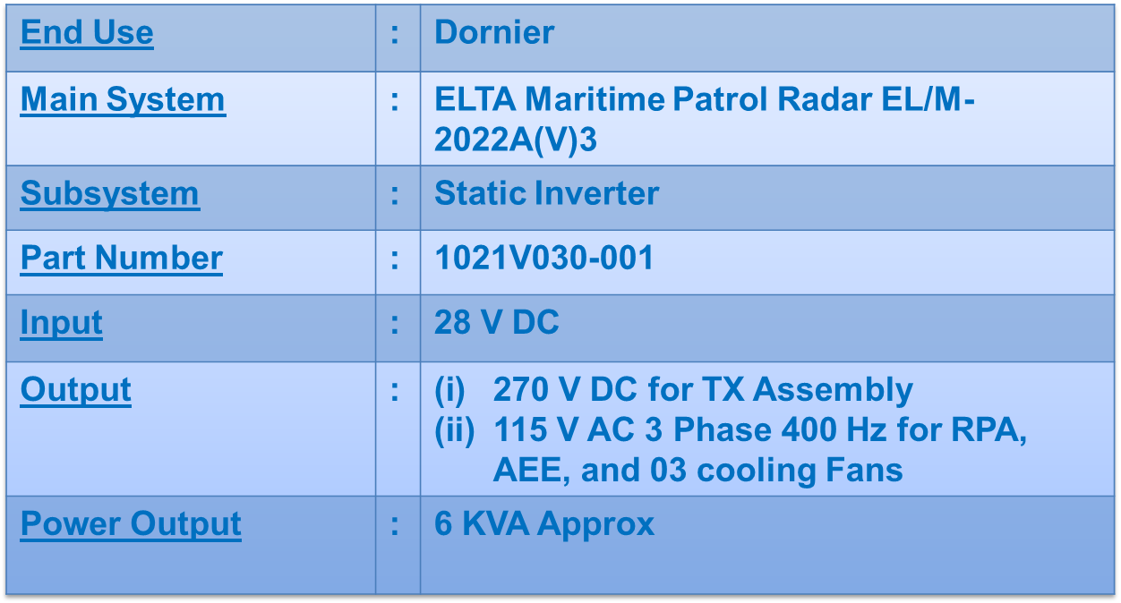
Three phase inverters DAPP
Scheme (Qty/ Cost/Cat/ DAs) | Remarks
Cat : Make II Cost : Rs 30 Lakh/ Set

Slide 65
Detonator N5 MK2 for CDSC 0.5 Kg with VH2 based Composition DAPI
Scheme (Qty/ Cost/Cat/ DAs) | Remarks
Cat : Make II Cost : Rs 8.1 Cr Qty : 180000 | The detonator, when initiated by the 0.22 RF cap(with VH-2 composition), should ensure explosion of CDSC 0.5kg The detonator should ensure a specified delay Life > 10 years Qty - 180000
65

Slide 66
Electronic Fuze for Anti-Submarine Rocket RGB 60 DAPI
Scheme (Qty/ Cost/Cat/ DAs) | Remarks
Cat : Make II Cost : Rs 1.3 Cr Qty : 500/yr | To be designed to explode the anti-submarine rocket RGB -60 at a preset depth or upon hitting the underwater target It should operate within the designated depth envelope Length - 361mm Dia. - 135mm Weight - 6.5kg Life > 10 years Qty - 500/year

Slide 67
Proximity, DA And Graze Fuze For 76/62 SRGM With Universal Capability For 76-127mm Ammunition DAPI
Scheme (Qty/ Cost/Cat/ DAs) | Remarks
Cat : Make II Cost : 60000/unit Qty : 5000 Fuzes @500/Yr | IN uses guns of calibers in the range of 76mm to 100mm, and envisaged to use guns of higher caliber up to 127mm It is proposed that the fuze for 76/62 SRGM be developed as an universal fuze with electronics that can be adapted for higher calibers The universal fuze should be adaptable to functioning in proximity(default) or DA mode, with graze action backup Proximity mode should have Self Destruct option after a specified flight time as backup

Slide 68
Detonator 7 sec Delay for Hand Grenade 36M DAPI
Scheme (Qty/ Cost/Cat/ DAs) | Remarks
Cat : Make II Cost : 800/detonator Qty : 5000 | The detonator, when initiated by the 0.22 RF cap(with VH-2 composition), should ensure explosion of CDSC 0.5kg The detonator should ensure a specified delay Life > 10 years Qty - 180000

Slide 69
‘MAKE’ Projects
Exploratory

Slide 70
‘MAKE’ PROJECTS - EXPLORATORY
 | Project
1 | High Speed Low Flying Target
2 | Diesel Engines for Boats
3 | Diesel Engines for Propulsion (5-10 MW)
4 | Shafting and Propellers
5 | Low Noise Water-jets for Surface Platforms
6 | Portable RPA Downlink Receiver with Display
7 | High Pressure Pre-formed Fuel Pipelines : Aero -Applications

Slide 71
‘MAKE’ PROJECTS - EXPLORATION
 | Project
8 | Conformal Array Line of Sight Communication Antenna
9 | Float Smoke and Flame A/c 3.5 lbs No.2 Mk2
10 | Limpet Mine ‘MK 414’(7Kg)
11 | Limpet Mine ‘MK 430’ (15 Kg)
12 | Chaff Payload for Kavach Rockets, LRCR, MRCR & SRCR
13 | Light Weight Composite Material Portable Diesel Driven Fire Pumps

Slide 72
Diesel Engines for Boats DME
Scheme (Qty/Cost/ Cat/ DAs) | Remarks
Cost 150 Cr ( 100 Cr development cost) Qty : 500 + DAs M/s Bharat Forge M/s KOEL M/s Cotton Greaves M/s EC Blades and Tools M/s Cooper Co-operation M/s Ashok Leyland | I N Requirements Power rating 6 -10 MW. Prototype power rating 10 MW Inspection, acceptance and testing of engines is governed by DEF STAN 02-313, 362, DME 303D Type testing of first engine of each model Compliance to Tier – II Emission norms

Slide 73
Diesel Engines for Propulsion DME
Scheme (Qty/Cost/ Cat/ DAs) | Remarks
Cost : 532 Cr (Envisaged development cost – Rs 591.6 Cr/ two DAs. Govt funding 90% of development cost under Make-I) Qty : 25 + DAs M/s EC Blades and Tools M/s KOEL M/s Bharat Forge | I N Requirements Power rating 220 – 330 HP To be integrated with suitable propulsion system (stern drive) ‘Classification Standards’ applicable Less stringent than Def/ Mil standards

Slide 74
Shafting and Propellers DME
Scheme (Qty/Cost/ Cat/ DAs) | Remarks
Proposed Cat : Make I Cost : Not Indicated Qty : 37 + Power Range: 1.2-18 MW DAs M/s Fouress Engg Ltd M/s Geeta Engg Works M/s HEC Ltd M/s L&T M/s Bharat Forge | IN REQUIREMENTS All shaftlines and PSI of major warships imported; high acquisition and life cycle cost Basic ‘know-how’ and capability available with the Industry for small crafts and barges Development of indigenous capability – a major boost to ‘self- reliance’ and ‘development capability

Slide 75
Low Noise Waterjets for Surface Platforms DME
Qty | 200 +
Approx Cost | (to be ascertained during Industry interaction/Feasibility Studies)
Proposed Category | Make II
Background | Hybrid Propulsion System combining Conventional screw propellers and water jets
Technological Challenges | Design incorporate a stator in order to redirect the rotor. Screw propeller swirl. The impeller is enclosed within the nozzle.

Slide 76
Portable RPA Downlink Receiver with Display
Brief Specification : The Downlink of RPA displays the data output from airborne sensors that are encrypted at the aircraft and transmitted to ground control station. It is proposed to develop a portable downlink receiver which should be able to receive, decrypt and display the data.
Projected Time Frame : Five years
Technology : Data link technology (Spread Spectrum, Encryption and Decryption)
Tentative Quantity to be procured : Above 06
Tentative Timeline for Induction : 2019 – 24

Slide 77
Materials For High Pressure Fuel Pipelines
Brief Specification : It is proposed to develop Fuel and Hydraulic pipelines of the aircraft that are made of special materials for high strength and light weight
Projected Time Frame : Five years
Technology : Material Science / Metallurgy
Tentative Quantity to be procured : Approx 1000 of different sizes
Tentative Timeline for Induction : 2019 – 24

Slide 78
Conformal Array Line of Sight Communication Antenna DEE
Qty | 10
Approx Cost | (to be ascertained during Industry interaction/Feasibility Studies)
Proposed Category | Make I
Background Info | - This is for improving stealth technology of ship by reducing RCS by reducing number of antennas
Technological Challenges (If any): | - Conformal Antenna Design - Array Design and Fabrication - Common Aerial Working (CAW) technology

Slide 79
Float Smoke and Flame A/c 3.5 lbs No.2 Mk2 DAPI
Qty | 200
Approx Cost | (to be ascertained during Industry interaction/Feasibility Studies)
Proposed Category | Make II
Background | Used by aircrafts/ helicopters to indicate the positions at sea. When dropped into water from aircraft, the emit smoke and spontaneous inflammable vapor which illuminate the surrounding area.
Technological Challenges

Slide 80
Limpet Mine ‘MK 414’(7Kg) DAPI
Qty | 100 / year
Approx Cost | Rs 1.6 Cr (to be ascertained during Industry interaction/Feasibility Studies)
Proposed Category | Make II
Background | - Limpet Mine 15 Kg - The hemispherical pressure resistant mine body is made of fiber material with provisions of magnets capable of sticking to ship’s hull and explode with the help of time fuze and detonator
Technological Challenges

Slide 81
Limpet Mine ‘MK 430’ (15 Kg) DAPI
Qty | 100
Approx Cost | (to be ascertained during Industry interaction/Feasibility Studies)
Proposed Category | Make II
Background | - Limpet Mine 15 Kg - The hemispherical pressure resistant mine body is made of fiber material with provisions of magnets capable of sticking to ship’s hull and explode with the help of time fuze and detonator
Technological Challenges

Slide 82
Light weight Composite Material Portable DD Fire Pp DOI/ DNBCD
Qty | 100
Approx Cost | To be ascertained during industry interaction
Proposed Category | Make I
Background | Onboard use for firemain system Suction from Sea and feedwater Pump should be light and ergonomic
Technological Challenges | - Capacity 37 TPH - Weight not exceeding 85 Kgs Dimensions not exceeding 600 X 600 X 600 mm

