Slide 1
ORDNANCE FACTORY BOARD
WELCOMES & FELICITATES
SMT NIRMALA SITHARAMAN
HON’BLE RAKSHA MANTRI
AND
SHRI YOGI ADITYANATH
CM, UTTAR PRADESH
16TH APRIL 2018

Slide 2
ORDNANCE FACTORIES SETUP
Ordnance Factory Board (OFB) is the oldest and largest Government production organization functioning under Department of Defence Production, Ministry of Defence
OFB is a conglomerate of 41 Ordnance Factories and 16 other support units, located throughout the country, manufacturing from tent to tank

Slide 3
HISTORICAL EVOLUTION
The first factory (Gun & Shell Factory, Cossipore, Kolkata) was established way back in the year 1801
At the time of Independence, there were 18 Odnance Factories
4 Factories were added in the wake of the Chinese aggression
By the time of the Bangladesh liberation, there were 29 factories
In the post 1971 scenario, 10 more factories were established
Post Kargil, 2 factories (at Nalanda and Korwa) were established

Slide 4
Rich and Wide Spectrum Experience
More than 2 centuries of experience of Defence production; wide technology spectrum; state-of-art Plant & Machinery
  Stringent quality standards and parameters
  Fair safety track record with in-built safety parameters
  Robust R&D infrastructure since 2006 with 13 Ord Dev Centres

Slide 5
OF and Make in India
87% overall indigenization achieved
22% of OFB turnover from indigenously developed products
  61 items developed through in-house R&D are with Armed Forces
Taking Concrete steps towards cost reduction and image refurbishing

Slide 6
Ordnance Factories
A Mine of Resources
A Plethora of Opportunities to UP Defence Corridor Inductries

Slide 7
9 OFs around UP Defence Corridor
5 OF at Kanpur
  ORDNANCE FACTORY KANPUR: Large Calibre Ordnances for Tanks/Guns, shells, etc
  FIELD GUN FACTORY KANPUR: Large Calibre Ordnances for Tanks and Guns
  SMALL ARMS FACTORY KANPUR: Small Arms
  ORDNANCE EQUIPMENT FACTORY KANPUR: Troop comfort items
  ORDNANCE PARACHUTE FACTORY KANPUR: Parachutes, assault boats, bridges

Slide 8
OFs and UP Defence Corridor
ORDNANCE FACTORY MURADNAGAR: Shells, bombs, etc
ORDNANCE EQUIPMENT FACTORY HAZRATPUR: Uniform, Troop comfort items
ORDNANCE CLOTHING FACTORY SHAHJAHANPUR: Troop comfort items including blankets and ECC uniforms
ORDNANCE FACTORY PROJECT KORWA: Small Arms (Carbines)

Slide 9
OFs and Pvt Sector Participation
A robust procurement policy
Nurturing 4000 indigenous vendors
More than 20 items offered for indigenization at Defence Industry Development Meet on 18th & 19th Jan 2018

Slide 10
OFs: Prospects for UP Ind Corr Industry
Ordnance Factories can join hands with manufacturers of:
  Sub-systems and components
  Quality testing and support equipment like gauges, tools, jigs and fixtures
MSME
  Dependence of Ordnance Factories and interaction with them is expected to be intense, long-term and synergistic

Slide 11
OFs: Facilities for UP Ind Corr Industry
Testing facilities and Proof range offered to private industries at reasonable rates
      Details next 2 slides

Slide 12
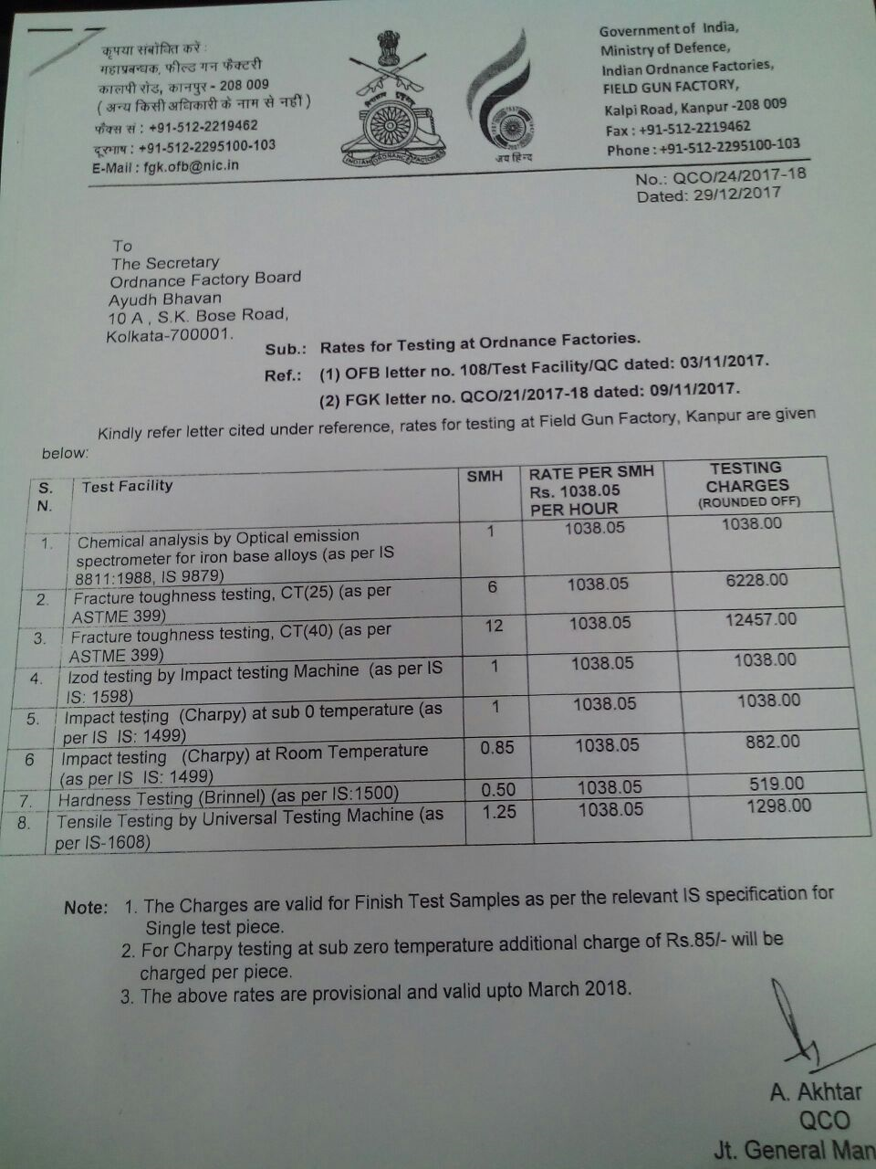

Slide 13
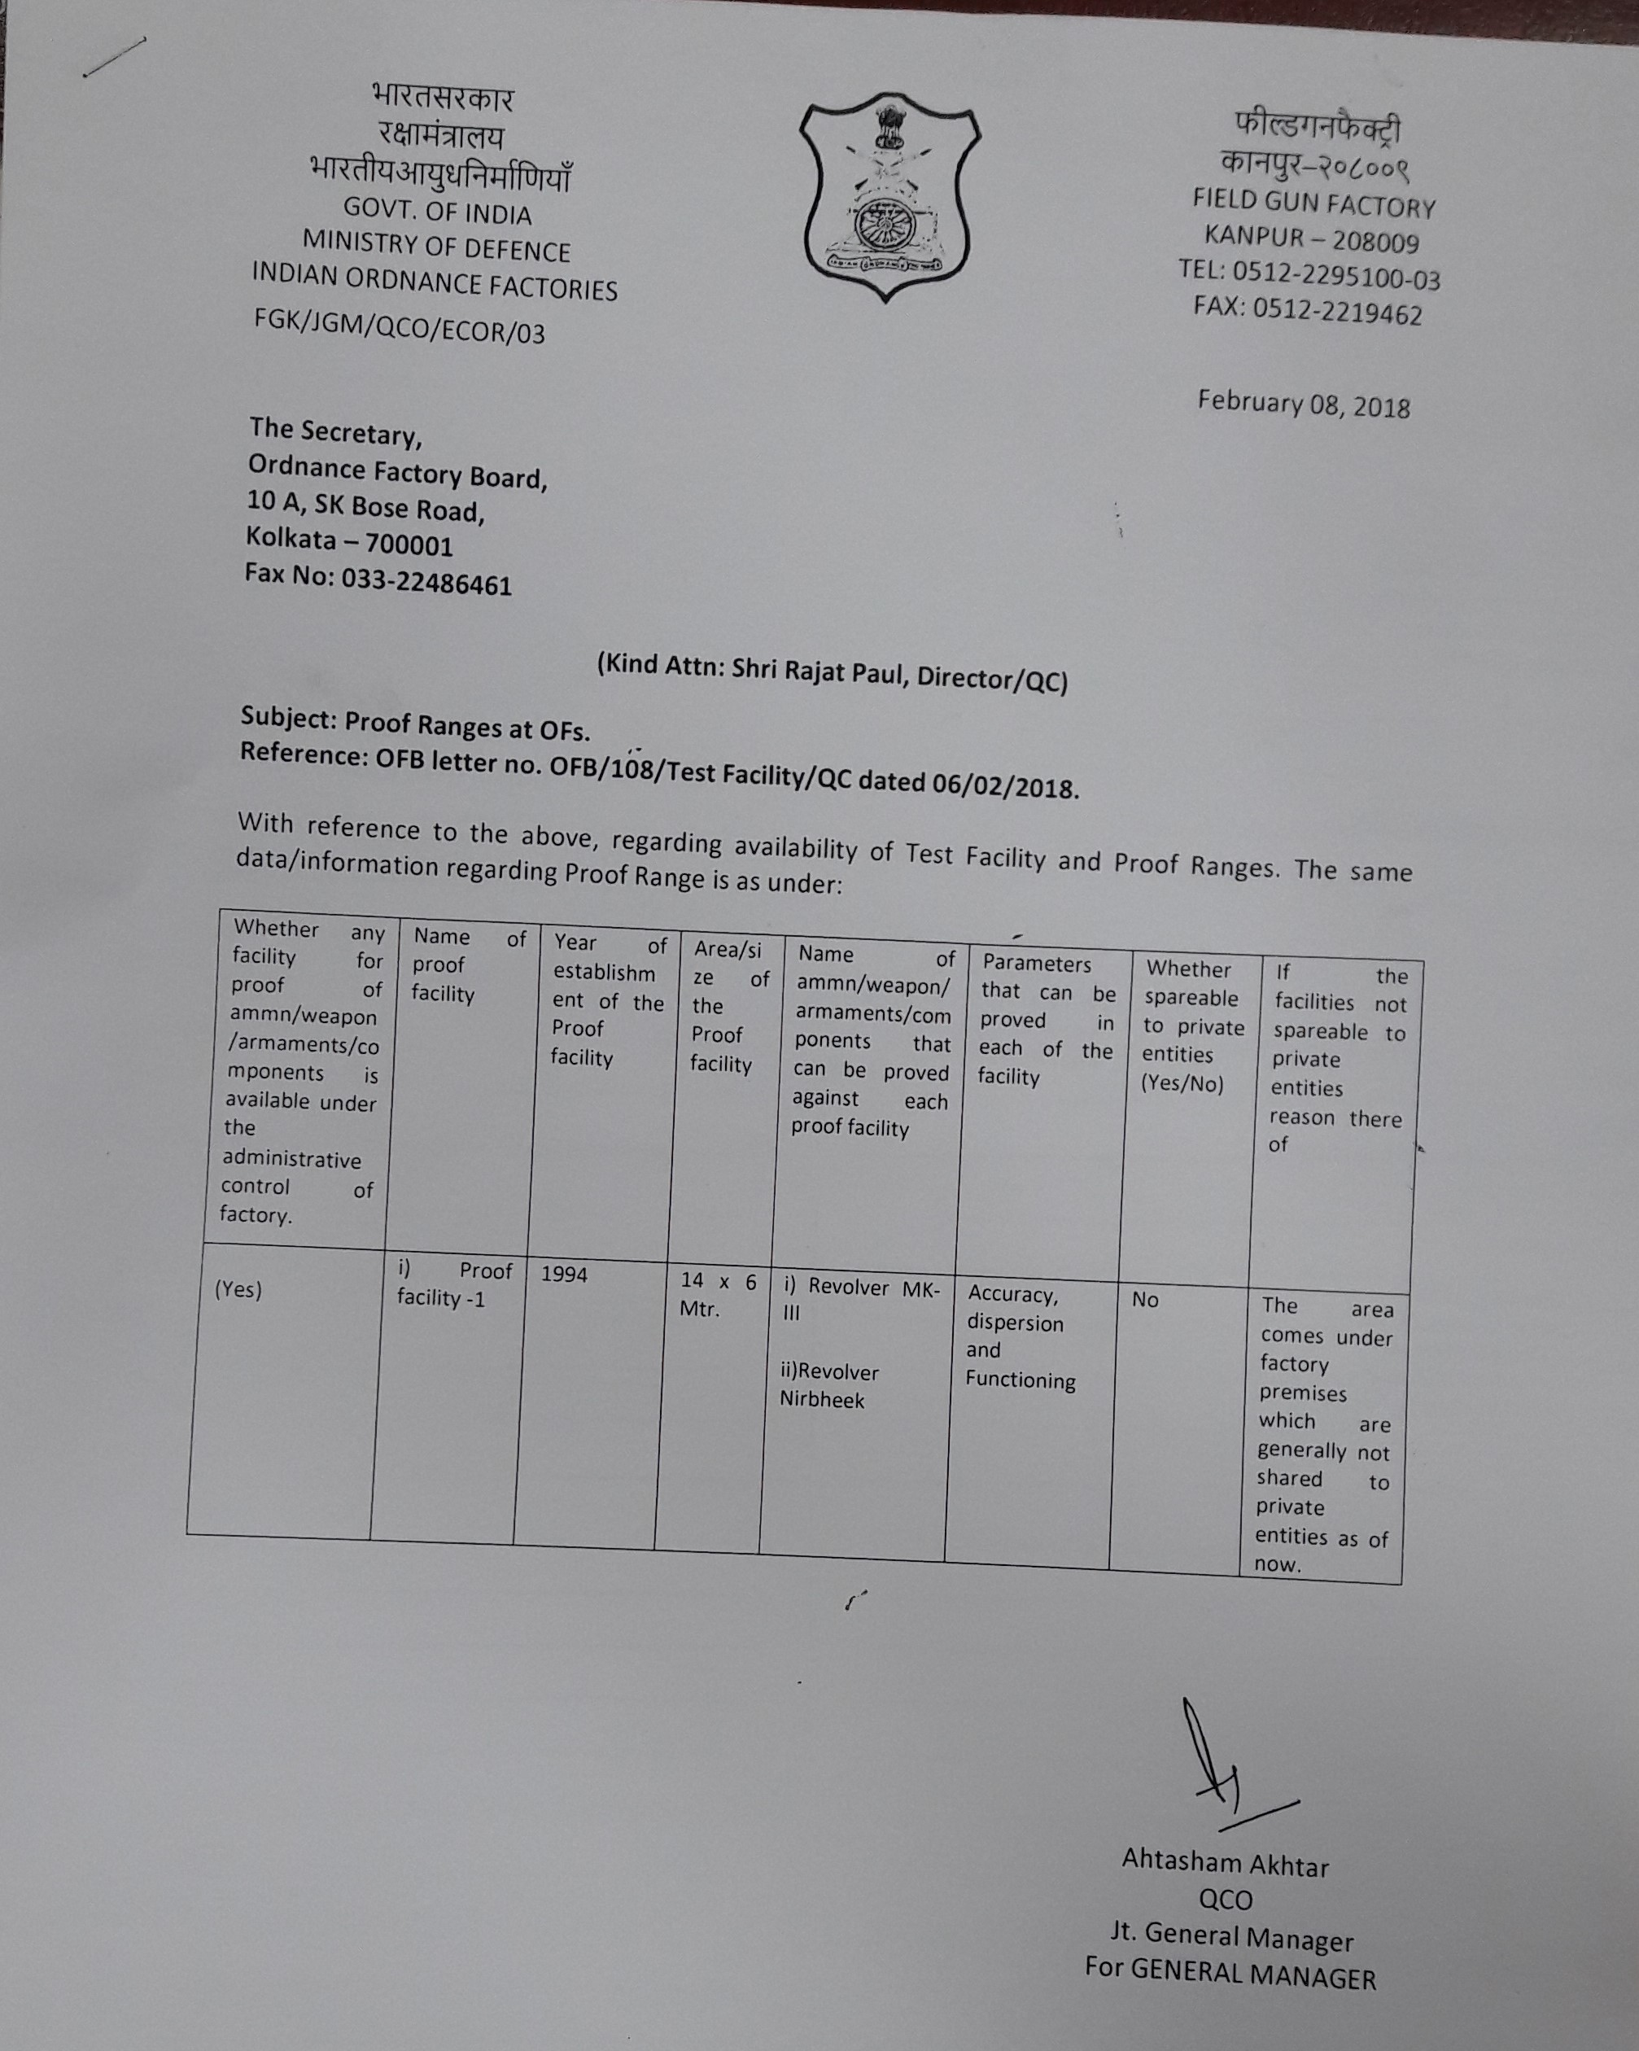

Slide 14
OFs: Synergy with Industry
For manufacturers of items already being made by Ordnance Factories, there is scope for private players also because of our limited capacity or higher demand

Slide 15
OFs: Pitfalls for Pvt Ind in Corridor
OFB demand may not always be of EOQ level, but is generally consistent and most often very critical
Pvt Industry has to face Competition each year as demands are annual with essential tendering each year

Slide 16
OFs: Policy Enablement Needed: Seeding and Nurturing Pvt Industry in Up Industrial Corridor
Ordnance Factories and Pvt Ind cannot afford the vicissitudes of annual requisition and procurement
  Government, as an enabler may, therefore, consider coming out with a Policy on Ancillarisation between Ordnance Factories and private players / MSMEs

Slide 17
OF Enablement for UP Ind Corridor
  Annual Contracts:
    does not allow for serious investment and professional relationship building
    Are also not cost viable
Long-term, say 3-5 years, contract, instead of the present one-year term
  Vagaries of cost/price fluctuations could be factored in such long-term contracts
  The present system is detrimental for quality which comes with consistency of working together

Slide 18
THANKS

