Slide 1
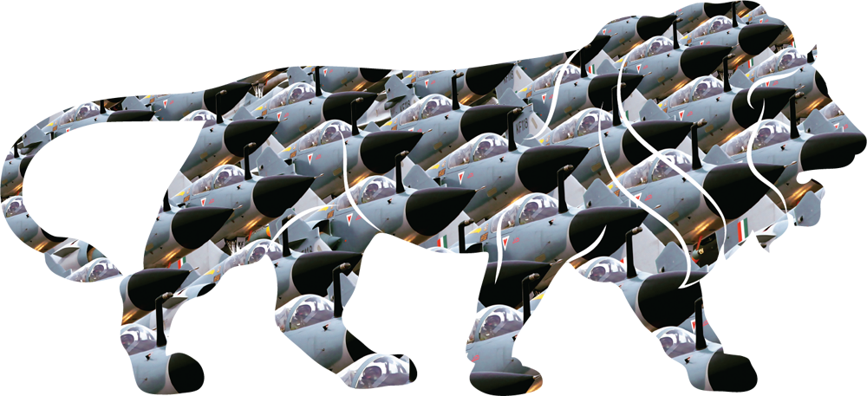
Defence Industrial Corridor in Uttar Pradesh
... विकास की साझेदारी, सुरक्षा की ज़िम्मेदारी

Slide 2
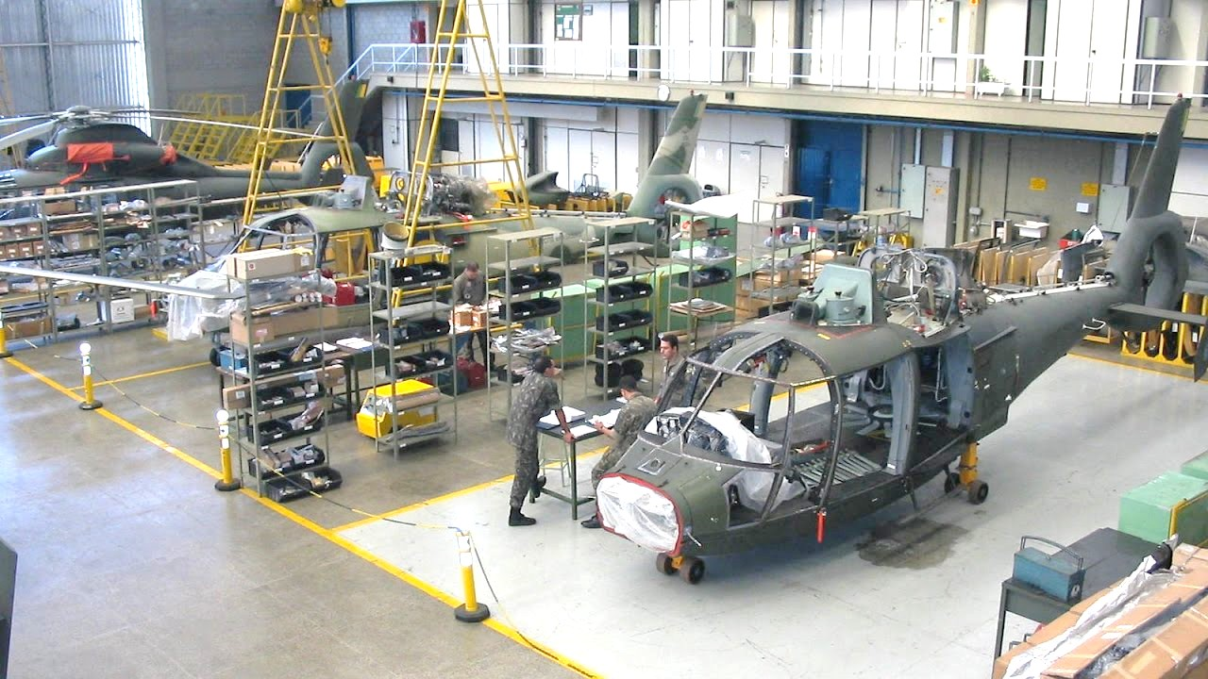
ADVANTAGE UTTAR PRADESH
Country’s 4th largest state, 3rd largest economy
Home to 16.5% of India’s population
Largest market and consumerplace
Amongst the top 5 manufacturing state
2nd highest number of SMEs in India
13.26% growth in exports (CAGR) (2012-17)

Slide 3
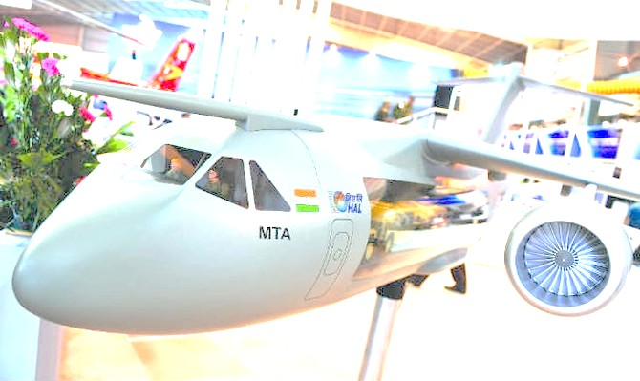
DEFENCE & AEROSPACE SECTOR Existing Manufacturing base
List of Prominent Ordnance Factories in UP
Ordnance Factory, Kanpur Small Arms Factory, Kanpur Field Gun Factory, Kanpur Ordnance Equipment Factory, Kanpur Ordnance Parachute Factory, Kanpur Ordnance Equipment Factory, Tundla Ordnance Factory, Korwa Ordnance Factory, Muradnagar, Ghaziabad Ordnance Clothing Factory, Shahjahanpur
Home to prominent PSUs –
Three HAL manufacturing units, Nine Ordnance Factories, Bharat Electronics Ltd, etc.
R&D and Innovation Base
Key R&D institutes including DRDO, ASERDC-HAL, etc.
Prominent Forensics Science Laboratories
List of Prominent manufacturing units of HAL
HAL Transport Aircraft Division, Kanpur HAL Accessories Division Lucknow HAL Avionics Division Korwa
Others - Bharat Electronics Ltd, Ghaziabad Naini Aerospace Ltd – HAL

Slide 4
The Announcement
Announced by Hon’ble Prime Minister, Shri Narendra Modi at UP Investors Summit in February 2018
Worth INR 20,000 crore proposed in Bundelkhand region
Estimated to create over 2.5 lakh employment opportunities

Slide 5
DEFENCE CORRIDOR Contours
Passing through Aligarh, Agra, Jhansi, Chitrakut including Kanpur, Lucknow
These districts have strong ancillary base to support the needs of defence manufacturing and ensure continuous supply of raw materials, labour, etc.
Large parcels of affordable land available in the Bundelkhand region
Region is best suited for developing economic testing and R&D facilities for the sector
Nearly 3000 hectares of land to be notifed and purchased

Slide 6
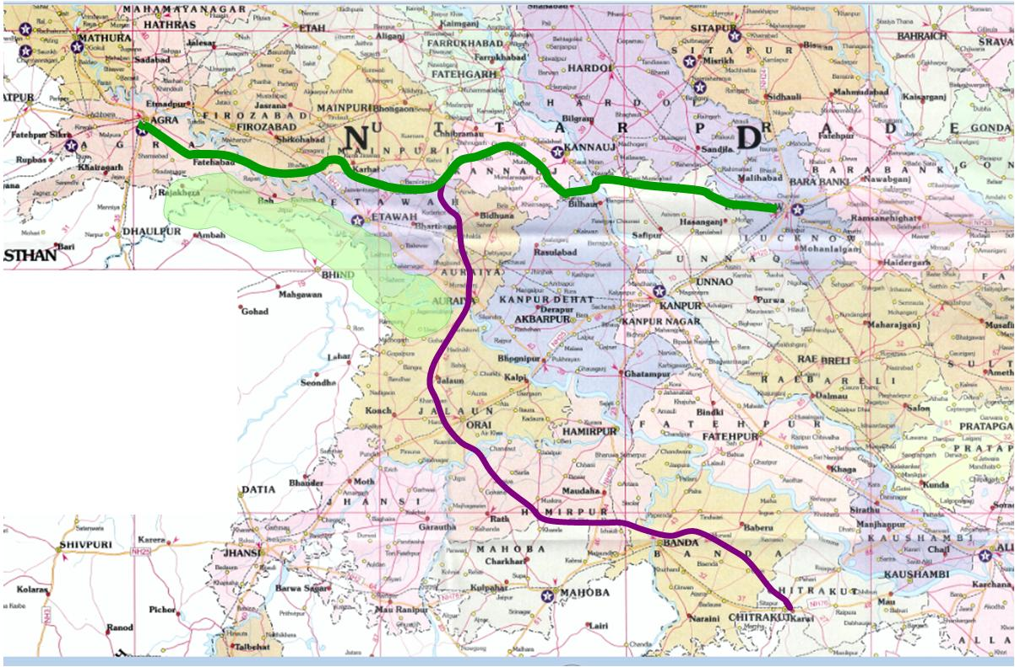
DEFENCE INDUSTRIAL CORRIDOR – UP
Catchment Area
Upto Aligarh
Kudrail
Agra-Lucknow Expressway
(operational)
Bundelkhand Exp’way
(Proposed Alignment)
Secondary Catchment Area~ 100 km
Primary Catchment Area~ 50 km
Bharatkoop

Slide 7
Connectivity
Air: Operational Airport at Agra
Rail: Connected directly to National Network, ~50 Kms from EDFC (Tundla)
Road: Connected via AL Expressway & National Highways
Connectivity
Air: Operational Airport at Kanpur
Rail: Connected directly to National Network, ~50 Kms from EDFC (Bhaupur)
Road: Connected via National Highways & ~65 Kms from AL Expressway
Agra Node
Kudrail
Kanpur Node
Agra-Lucknow Expressway
(operational)
Connectivity
Air: Operational Airport at Kanpur ~125 Kms
Rail: Connected directly to National Network, ~50 Kms from EDFC (Bhaupur)
Road: Connected via National Highway & proposed Bundelkhand Expressway
Bundelkhand Exp’way
(Proposed Alignment)
Jalaun Node
Connectivity
Air: Operational Airport at Khajuraho ~200 Kms
Rail: Connected directly to National Network, ~180 Kms from EDFC (Prempur)
Road: Connected via National Highway & proposed Bundelkhand Expressway
Connectivity
Air: Operational Airport at Gwalior ~100 Kms
Rail: Connected directly to National Network, ~250 Kms from EDFC (Prempur)
Road: Connected via National Highway & ~50 Kms from proposed Bundelkhand Expressway
Jhansi Node
Bharatkoop
Chitrakoot Node

Slide 8
DEFENCE INDUSTRIAL CORRIDOR - UP SME Base (1/3)

Slide 9
DEFENCE INDUSTRIAL CORRIDOR - UP SME Base (2/3)

Slide 10
DEFENCE INDUSTRIAL CORRIDOR – UP SME Base (3/3)

Slide 11
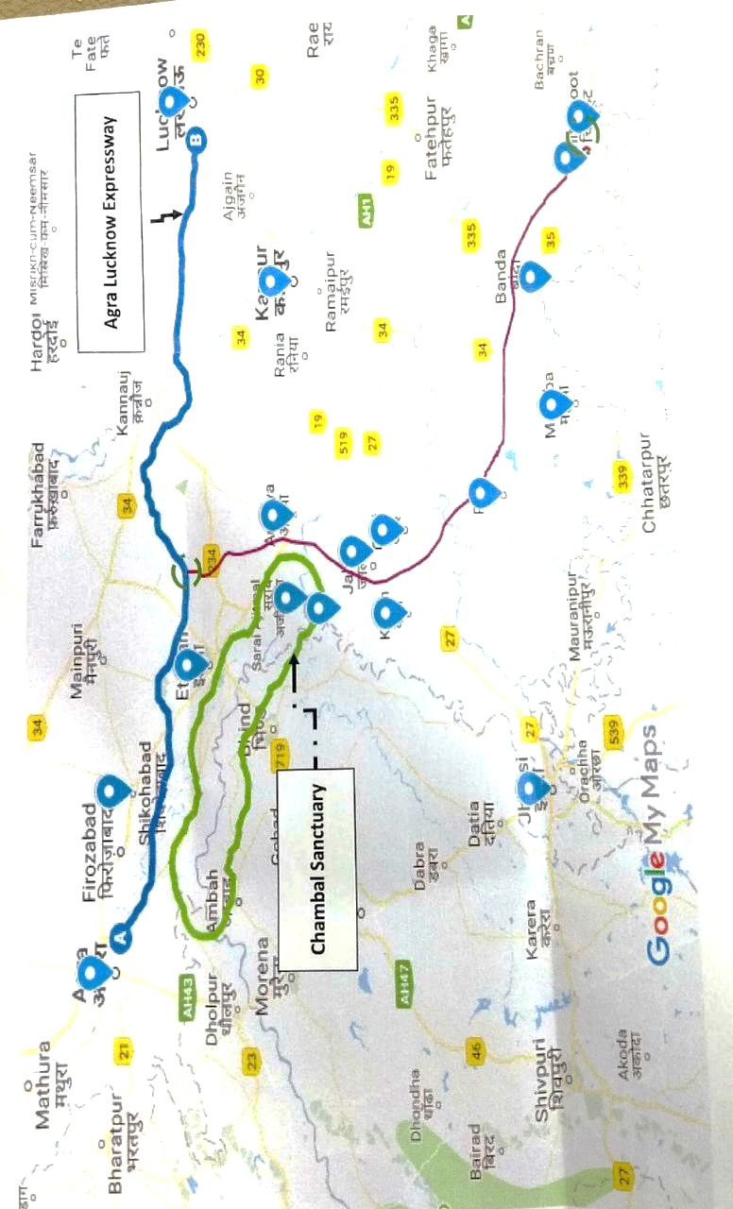
DEFENCE INDUSTRIAL CORRIDOR - UP Strategy
Expanding the Ordnance factories in the state
Mobilising Private investments
Mobilising the SME ecosystem in the state
Bridging the market gaps and connect the ancillary units in the state to meet the requirements of Defence PSUs
Developing the export oriented manufacturing base for defence sector

Slide 12
DEFENCE INDUSTRIAL CORRIDOR – UP Enabling Infrastructure
Existing
Located on Golden Quadrilateral with excellent road network
Alongside the catchment area of AKIC and EDFC
Agra Lucknow Expressway
Major national & international airports connecting the rest of India
Strong Logistics infrastructure – at Kanpur, Dadri, Boraki, Varanasi
Upcoming
Proposed Bundelkhand Expressway linking Chitrakoot to Agra Lucknow Expressway
Proposed Poorvanchal Expressway linking Lucknow to Ghazipur
Upcoming international airports at Jewar in NCR
Proposed NW-1 connecting Allahabad to Haldia port

Slide 13
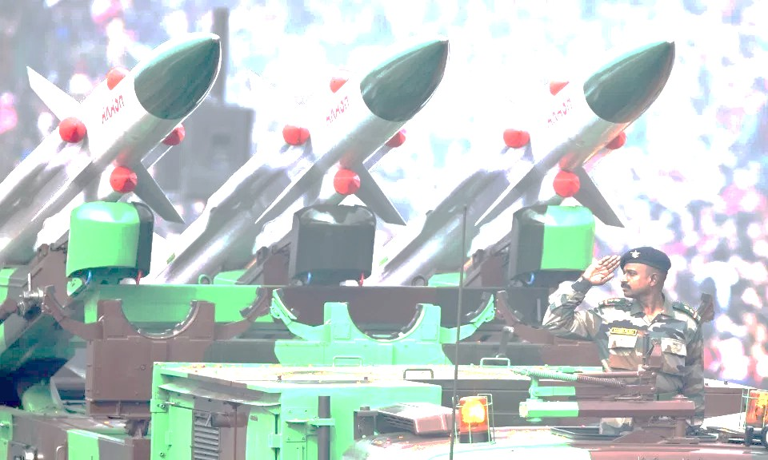
DEFENCE INDUSTRIAL CORRIDOR - UP Investment Opportunities
Auto related components & Automobile manufacturing for military
Testing facilities - Development testing range for artillery and other military equipment
Police modernization, Forensics Centres
Drones Manufacturing and Testing facilities
Aircraft/ Helicopter Manufacturing/ Assembling Units
Defence Park at Jhansi, Agra, Kanpur
Aerospace Park at Lucknow, Kanpur, Agra
Expansion of Defence Public Sector Units (DPSUs)
Leather & Textile hub at Agra for development of technical textile
Engineering/Electronics manufacturing hub at Agra, Kanpur, Gautambuddha Nagar, Ghaziabad
Indigenisation of items imported

Slide 14
DEFENCE INDUSTRIAL CORRIDOR – UP
Proposed UP Defence & Aerospace Manufacturing Policy

Slide 15
DEFENCE INDUSTRIAL CORRIDOR – UP
Proposed Defence & Aerospace Manufacturing (D&A) Policy
Salient Features
Attracting Defence PSUs, Mega and Anchor projects
Promoting development of Private Defence Parks with plug & play facilities
More incentives are offered for investments made in Defence Corridor
Promoting Investments in Bundelkhand & Poorvanchal
Supporting industry specific incentives including rebate on freight and transportation charges, for developing R&D and testing facilities, capacity building, towards patent & registration fee is also offered
Quality Power supply
Easy Labour permits
Industrial Security
Simplified Procedures
Single Window

Slide 16
DEFENCE INDUSTRIAL CORRIDOR – UP
Proposed Defence & Aerospace Manufacturing (D&A) Policy
Incentives to Private D&A Park
Parks providing ‘plug-and-play’ industrial infrastructure, including –
Manufacturing area (components, sub-components, sub-assemblies, aerospace parts) and SEZ, Testing centre, Hardware/Embedded Technology Centre, Technology innovation centre, and Housing & Common facility centre
Developed on >100 acres in Bundelkhand & Purvanchal Region, >150 acres in Madhyanchal & Paschimanchal
Incentives at par to those given to Private Industrial Parks under UP IIEPP 2017 –
Particular | Incentive (as under UP IIEPP 2017)
Loan taken to buy land | Interest reimbursement @50% of annual interest, for 7years upto INR 50 lakh p.a per park
Loan taken to build infrastructure | Interest reimbursement @60% of annual interest, for 7years upto INR 10 crores p.a with an overall ceiling of INR 50 crores per park
Loan taken to build common facility | Interest reimbursement @60% of annual interest, for 7years upto INR 5 crores p.a with an overall ceiling of INR 30 crores per park
Stamp duty | 100% exemption to the developer

Slide 17
DEFENCE INDUSTRIAL CORRIDOR – UP
Proposed Defence & Aerospace Manufacturing (D&A) Policy
Incentives to D&A Units (1/4)
Case to case incentives to –
Mega units
Capex >INR 300 crores or atleast 1000 direct employment in Bundelkhand/ Poorvanchal
Capex >INR 400 crores or atleast 1500 direct employment in Madhyanchal/ Paschimanchal**
Capex >INR 500 crores or atleast 2000 direct employment in GB Nagar/Ghaziabad
Anchor unit along with their Vendor units
Defence PSUs (DPSU) with min fixed capex of INR 1000 crores, located anywhere in the state
Incentive on Land | Category
Land on lease at subsidised rates anywhere in the state | DPSUs
Reimbursement upto 25% of the cost of land in the notified areas of Defence Corridor | Mega units & Anchor units
Reimbursement upto 15% of the cost of land in the notified areas of Defence Corridor | Large units
Reimbursement upto 10% of the cost of land in the notified areas of Defence Corridor | MSME units

Slide 18
DEFENCE INDUSTRIAL CORRIDOR – UP
Proposed Defence & Aerospace Manufacturing (D&A) Policy
Incentives to D&A Units (2/4)
Particular | Details ( as under UP IIEPP 2017)
Loan taken for plant & machinery | Interest reimbursement @5% p.a. for first 5 years upto INR 50 lacs p.a per unit.
Loan taken to build infrastructure | Interest reimbursement @5% p.a. for 5years upto max INR 1 crore
Loan taken for setting up Industrial Research | Interest reimbursement @5% p.a. for 5 years subject to an overall ceiling of INR 1 Crore.
Stamp Duty Exemption | 100% in Bundelkhand, Purvanchal region; 75% in Madhyanchal, Paschimanchal (except GB Nagar, Ghaziabad); 50% in GB Nagar, Ghaziabad
Electricity duty | 100% exemption for 10years to new units
SGST reimbursement | 90% to MSME for 5years, 60% to large units for 5years, 70% to Mega units for 10years.
EPF reimbursement | 50% of employer’s contribution on providing direct employment to 500 or more unskilled workers, and additional 10% of employer’s contribution on direct employment to 200 skilled and unskilled workers.

Slide 19
DEFENCE INDUSTRIAL CORRIDOR – UP
Proposed Defence & Aerospace Manufacturing (D&A) Policy
Incentives to D&A Units (3/4)
Particular | Details
Tax Incentive | 100% reimbursement of net SGST on all input material (excluding Aviation Turbine Fuel) for aircrafts which are brought in specifically for MRO in UP, for 10 years to all new D&A units (Aviation Turbine Fuel is already subsidised under UP Civil Aviation Policy 2017 – Section 7.1.1, 8.1.1, 8.2.1, 8.5.2.1)
Rebate on Transportation charges | For transportation of imported equipment, plant/ machinery from logistics parks/harbour / port to the production site within UP state | Subsidy of 50% of cost, up to max. INR 2 cr, up to the start of first year of production
 | For transportation of finished products from the unit to logistics parks, harbour / port | Subsidy of 30% of cost up to max. INR 1 cr, for 5years from start of commercial production
Setting up ETP | 20% reimb of project cost, upto maximum INR 1 cr
Setting up R&D and Testing Centres | 10% subsidy on investment > INR 10 cr, @ max INR 10 cr per investment In case criteria are fulfilled within 2 years of going live, the assistance will be granted retrospectively on fulfilling following order requirements - Centre should either have bagged a direct order** of at least INR 5 cr or should be service provider to a manufacturer having a minimum of INR50crore order from authorised** (**from the MoD/MHA/ or equivalent foreign governments/ civilian aerospace supplier or an MRO facility.)

Slide 20
DEFENCE INDUSTRIAL CORRIDOR – UP
Proposed Defence & Aerospace Manufacturing (D&A) Policy
Incentives to D&A Units (4/4)
Particular | Details
Reimbursement of cost of tech transfer | 100% of cost of ToT reimb to Anchor Units towards first 5vendors, and 50% for next 5 vendors (ceiling of INR 50 lakhs for each vendor unit)
Patent filing fees | 100% reimbursement for domestic patent registration 50% reimb for international patent registration subject to max INR 25 lakh
Trade Mark Registration Fees | 100% reimbursement subject to max INR 1 lakh
Quality certification fees | 100% reimbursement, subject to max INR 2lacs (only MSME units eligible)
Building Market | 50% reimb of cost of participation in international exhibitions / fairs up to max INR 5Lakh (only MSME units eligible)
Capacity building | Reimb @INR 10000 p/m per trainee for 6 months, upto max of 50 trainees p.u. p.a. to units providing on the job training for prescribed courses in D&A sector A&D units shall be handed over identified Government ITIs/ Polytechnics Universities (in India and abroad) with excellence in A&D training and research to tie up with universities in the State

Slide 21
THANK YOU
Kindly give your feedback & suggestions on the contact details below -

